Slide 1
ADTs
DS Sem 2 2015/16

Slide 2


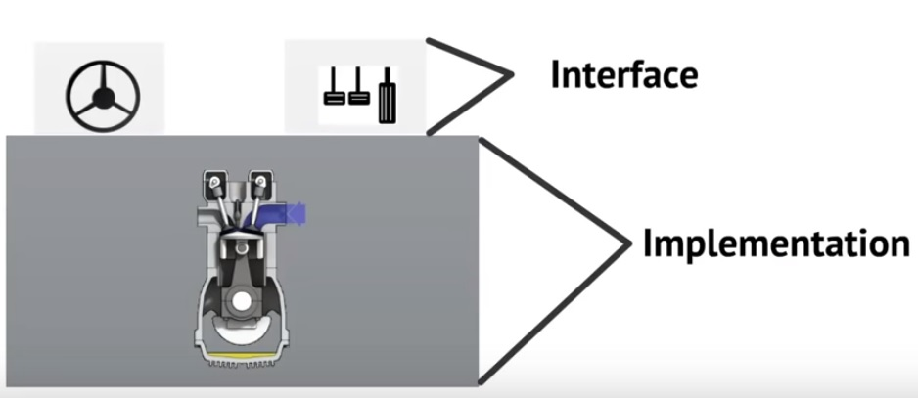

Slide 3


Slide 4

Example
Cinema Reservation System
(https://www.youtube.com/watch?v=HcxqzYsiJ3k)
Data?
Seats
Seats reserved or available
Operations ?
Determine availability of seats
Reserve a seat
Cancel a reservation
Find a block of available seats
Implementation?
Data Structure

Slide 5
What is ADT?
A type in which
What the operations of the type are is public
That is, public to the client
How the type is implemented is private
That is, private to the client
A type defines data items and associated operations, but not implementation (i.e., interface) Abstract = irrelevant details are ignored
The ADT is abstract because how the ADT is implemented is ignored

Slide 6
An abstract data type (ADT) is a model of a data structure that specifies:
the characteristics of the collection of data
the operations that can be performed on the collection
It’s abstract because it doesn’t specify how the ADT will be implemented.
A given ADT can have multiple implementations.

Slide 7


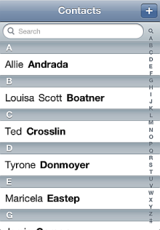
ADT Examples
The following are unrelated items :
A deck of playing cards
A set of index cards containing birthday information
Telephone numbers stored in your cellular phone
What do they share in common?

Slide 8
Each one is a collection of elements.
There is a first element.
There is a second element, third element, and so on.
There is a last element.
Given an element other than the last element, there is a ‘‘next’’ element.
Given an element other than the first element, there is a ‘‘previous’’ element.
An element can be removed from the collection.
An element can be added to the collection.
A specified element can be located in the collection by systematically going through the collection.

Slide 9
Advantage of ADTs
Shares data and operations.
Information hiding. That is, ADT hides the implementation details of the operations and the data from the users of the ADT. Users can use the operations of an ADT without knowing how the operation is implemented

Slide 10
Useful links
https://www.youtube.com/watch?v=HcxqzYsiJ3k
http://www.radford.edu/~nokie/classes/320/Abstract_Data_Types.html

